Slide 1
Macros and Preprocessors

Slide 2
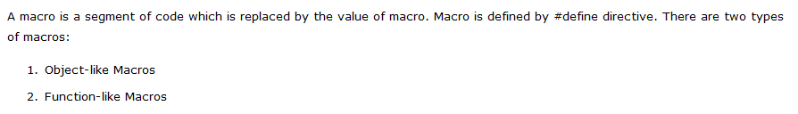
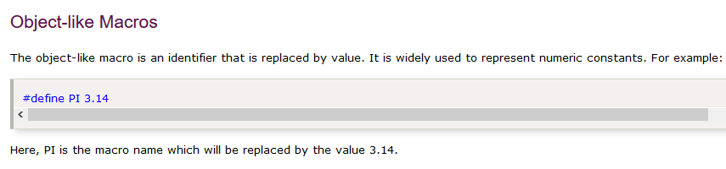

Macros

Slide 4
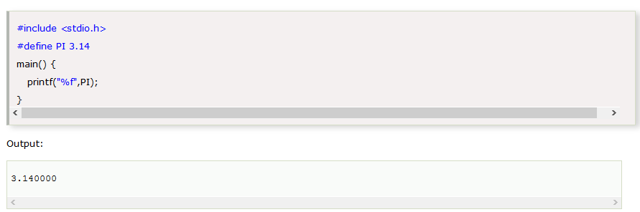

Slide 5
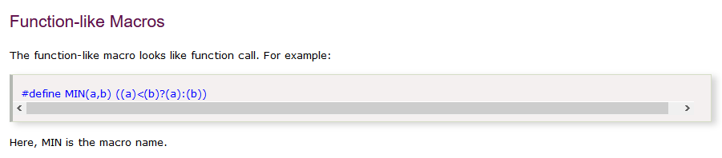
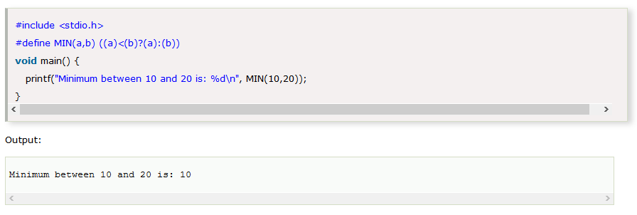

Slide 7
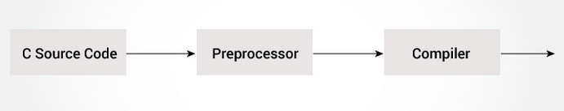
C Preprocessor
The C Preprocessor transforms your program before it is compiled.
These transformations can be the inclusion of header file, macro expansions etc.
C preprocessor is a text substitution tool, and it instructs the compiler to do the required preprocessing, before actual compilation.
All preprocessor commands start with a # symbol.

Slide 9
Some of the common uses of preprocessor directives are:
Including Header Files: # include.
eg. # include <stdio.h>
Here stdio.h is a header file.
The #include preprocessor replaces the above line with the contents of stdio.h header file.
You can also create your own header file and include it in your program using this
preprocessor directive.
eg. #include “my_header.h”

Slide 10
2. Macros using # define pre-processor directive.
We can define a macro in C using the # define preprocessor directive.
eg. #define PI 3.14159,
When we use PI in the program, it is replaced with 3.14159.

Slide 11
Thank You

